Slide 1





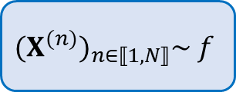
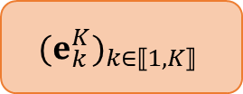






Pseudo-inputs
$$(e_{k}^{K})_{k∈⟦1,K⟧}$$
$$μ_{k}$$
$$VP_{λ}$$
Dense
$$p_{λ,φ}$$
$$Σ_{k}$$
Dense
$$μ_{x}$$
Dense
$$μ_{z}$$
$${(X}^{(n)})_{n∈⟦1,N⟧}\sim f$$
Dense
Dense
$$g_{θ}≈g^{∗}$$
Dense
Dense
Dense
$$Σ_{x}$$
Dense
$$Σ_{z}$$
$$E_{φ}$$
Latent Space
$${ D}_{θ}$$

